Slide 1

Stage 3 We Have Outland Empire At Home Course Designer: Marcel Englmaier
We Have Outland Empire At Home is a 44 round, 220 point Comstock Long course. There are 22 IPSC targets. The best two hits per target will score. The start signal is audible.
The Handgun start position is standing completely outside the shooting areas with wrists below belt. Handgun is loaded and holstered. The PCC start position is standing completely outside the shooting areas with PCC loaded, stock on belt, safety on.
On the audible start signal, engage all targets from within the shooting areas.

Slide 2
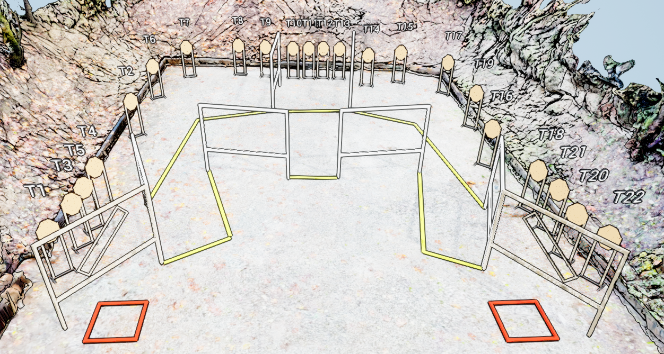
 | Stage 3 We Have Outland Empire At Home Course Designer: Marcel Englmaier

